Slide 1
Econ 100 Principles of Economics
Lecture 18
May 8

Slide 2
Today?
GROSS DOMESTIC PRODUCT
Issues
Inflation

Slide 3
GDP: Definition & Issues

Slide 4
The Measurement of Gross Domestic Product
Gross domestic product (GDP) is a measure of the income and expenditures of an economy.
GDP is the total market value of all final goods and services produced within a country in a given period of time.

Slide 5
Real versus Nominal GDP
Price changes can distort economic variables like GDP, so we have two versions of GDP: One is corrected for price changes, the other is not.
Nominal GDP values output using current prices. It is not corrected for price changes.
Real GDP values output using the prices of a base year. Real GDP is corrected for price changes.

Slide 6
EXAMPLE:
 | Pizza |  | Latte
year | P | Q | P | Q
2002 | $10 | 400 | $2.00 | 1000
2003 | $11 | 500 | $2.50 | 1100
2004 | $12 | 600 | $3.00 | 1200
Compute nominal GDP in each year:
2002: $10 x 400 + $2 x 1000 = $6,000
2003: $11 x 500 + $2.50 x 1100 = $8,250
2004: $12 x 600 + $3 x 1200 = $10,800
Increase:
37.5%
30.9%
Notes:
This example is similar to that in the text, but using different goods and different numerical values.
Suggestion: Ask your students to compute nominal GDP in each year, before revealing the answers. Ask them to compute the rate of increase before revealing the answers.
In this example, nominal GDP grows for two reasons: prices are rising, and the economy is producing a larger quantity of goods.
Thinking of nominal GDP as total income, the increases in income will overstate the increases in society’s well-being, because part of these increases are due to inflation.
We need a way to take out the effects of inflation, to see how much people’s incomes are growing in purchasing power terms. That is the job of real GDP.

Slide 7
EXAMPLE:
 | Pizza |  | Latte
year | P | Q | P | Q
2002 | $10 | 400 | $2.00 | 1000
2003 | $11 | 500 | $2.50 | 1100
2004 | $12 | 600 | $3.00 | 1200
$10
$2.00
Compute real GDP in each year, using 2002 as the base year:
Increase:
2002: $10 x 400 + $2 x 1000 = $6,000
2003: $10 x 500 + $2 x 1100 = $7,200
2004: $10 x 600 + $2 x 1200 = $8,400
20.0%
16.7%
Notes:
This example shows that real GDP in every year is constructed using the prices of the base year, and that the base year doesn’t change.
The growth rate of real GDP from one year to the next is the answer to this question:
“How much would GDP (and hence everyone’s income) have grown if there had been zero inflation?”
Thus, real GDP is corrected for inflation.

Slide 8
EXAMPLE:
year | Nominal GDP |  | Real GDP
2002 | $6000 |  | $6000
2003 | $8250 |  | $7200
2004 | $10,800 |  | $8400
In each year,
nominal GDP is measured using the (then) current prices.
real GDP is measured using constant prices from the base year (2002 in this example).
Notes:
The table in the top half of this slide merely summarizes the answers from the previous two slides. This table will be used shortly to compute the growth rates in nominal and real GDP, and to compute the GDP deflator and inflation rates.

Slide 9
EXAMPLE:
year | Nominal GDP |  | Real GDP
2002 | $6000 |  | $6000
2003 | $8250 |  | $7200
2004 | $10,800 |  | $8400
37.5%
20.0%
30.9%
16.7%
The change in nominal GDP reflects both prices and quantities.
The change in real GDP is the amount that GDP would change if prices were constant (i.e., if zero inflation).
Hence, real GDP is corrected for price increases.
Notes:
Again, the growth rate of real GDP from one year to the next is the answer to this question:
“How much would GDP (and hence everyone’s income) have grown if there had been zero inflation?”
This is why real GDP is corrected for inflation.

Slide 10
Nominal and Real GDP in the U.S.,1965-2005
Real GDP (base year 2000)
Nominal GDP
Notes:
The source I used: http://research.stlouisfed.org/fred2/
The original source: U.S. Department of Commerce: Bureau of Economic Analysis
Note: I created this graph in Excel. If you wish, you may be able to access the original Excel file simply by double-clicking on the graph. (I have embedded the full Excel file on this slide, rather than simply making a copy of the finished graph.)
Note: This graph is different than the one in this chapter of the textbook. The one in the textbook excludes nominal GDP, but includes shaded vertical bars over the dates of each recession.
Since you have just finished covering real vs. nominal GDP, it might be worthwhile pointing out the following to your students:
The graph shows that nominal GDP rises faster than real GDP. This should make sense, because growth in nominal GDP is driven by growth in output AND by inflation. Growth in real GDP is driven only by growth in output.
The two lines cross in the year 2000 (the base year for the real GDP data in this graph). This should make sense, because real GDP equals nominal GDP in the base year. (Better yet, ask your students whether there’s anything significant about the point where the two lines cross.)
Before the base year, real GDP > nominal GDP. For example, in 1970, nominal GDP is about $1 trillion, while real GDP is about $3.8 trillion (in 2000 dollars). This should make sense, because prices were so much higher in 2000 than in 1970, so using those high 2000 prices to value 1970 output would lead to a bigger result than valuing 1970 output using 1970 prices.
Similarly, after 2000, nominal GDP is higher than real GDP, because prices are higher in later years than they were in 2000.

Slide 11
The GDP Deflator
The GDP deflator is a measure of the overall level of prices.
Definition:
GDP deflator = 100 x
nominal GDP
real GDP
One way to measure the overall level of prices is to compute the percentage increase in the GDP deflator from one year to the next.
Notes:
The GDP Deflator gets its name because it is used to “deflate” (i.e., take the inflation out of) nominal GDP to get real GDP.

Slide 12
EXAMPLE:
year | Nominal GDP | Real GDP | GDP Deflator
2002 | $6000 | $6000
2003 | $8250 | $7200
2004 | $10,800 | $8400
100.0
14.6%
114.6
12.2%
128.6
Compute the GDP deflator in each year:
2002: 100 x (6000/6000) = 100.0
2003: 100 x (8250/7200) = 114.6
2004: 100 x (10,800/8400) = 128.6

Slide 13
Computing GDP
 | 2004 (base yr) |  | 2005 |  | 2006
 | P | Q | P | Q | P | Q
good A | $30 | 900 | $31 | 1,000 | $36 | 1050
good B | $100 | 192 | $102 | 200 | $100 | 205
Use the above data to solve these problems:
A. Compute nominal GDP in 2004.
B. Compute real GDP in 2005.
C. Compute the GDP deflator in 2006.
13
Notes:
The data in the table are for a hypothetical economy that produces two final goods, A and B. For all problems, use 2004 as the base year.
If you’re running short on time, you can skip part A – it’s the least challenging. If you only have time for one of the three, you might skip A and B, as C by itself covers all of the material: it requires students to compute nominal and real GDP before they can compute the GDP deflator.

Slide 14
Answers
 | 2004 (base yr) |  | 2005 |  | 2006
 | P | Q | P | Q | P | Q
good A | $30 | 900 | $31 | 1,000 | $36 | 1050
good B | $100 | 192 | $102 | 200 | $100 | 205
A. Compute nominal GDP in 2004.
$30 x 900 + $100 x 192 = $46,200
B. Compute real GDP in 2005.
$30 x 1000 + $100 x 200 = $50,000
14

Slide 15
A C T I V E L E A R N I N G 2: Answers
 | 2004 (base yr) |  | 2005 |  | 2006
 | P | Q | P | Q | P | Q
good A | $30 | 900 | $31 | 1,000 | $36 | 1050
good B | $100 | 192 | $102 | 200 | $100 | 205
C. Compute the GDP deflator in 2006.
Nom GDP = $36 x 1050 + $100 x 205 = $58,300
Real GDP = $30 x 1050 + $100 x 205 = $52,000
GDP deflator = 100 x (Nom GDP)/(Real GDP)
= 100 x ($58,300)/($52,000) = 112.1
15

Slide 16
GDP Does Not Value:
the quality of the environment
leisure time
non-market activity, such as the child care a parent provides his or her child at home
an equitable distribution of income
Notes:
Much of what Robert Kennedy said about GDP is correct.

Slide 17
Again: Is the US the richest country in the world?
The US ranks around 30th in the world in health statistics such as life expectancy and infant mortality.
The US has much bigger crime rate than in Europe or Japan: in per capita terms, the US has 8 times more people in prison than Europe and 12 times more than Japan.

Slide 18
U.N. Human Development Index
Health
Income
Learning

Slide 19
Human development index
HDI measures a nation's achievement in three dimensions of human development:
long and healthy life (indicated by life expectancy at birth),
knowledge (indicated by literacy and school enrollment rates), and
decent standard of living (indicated by GDP per capita).
In 2014:
Top 10: Norway, Australia, Switzerland, Netherlands, United States, Germany, New Zealand, Canada, Singapore, Denmark
In 2008: Iceland, Norway, Canada, Australia, Ireland, Netherlands, Sweden, Japan, Luxembourg, Switzerland.
Bottom 10: Sierra Leone, Central African Republic, Dem. Rep. of Congo, Liberia, Mozambique, Niger, Burkina Faso, Burundi, Guinea-Bissau, and Chad.

Slide 21
Report by the Commission on the Measurement of Economic Performance and Social Progress
There are concerns about the relevance of the GDP as a measure of societal well-being, as well as measures of economic, environmental, and social sustainability.
At the beginning of 2008, on the French government’s and in particular President Sarkozy’s initiative, the Commission on the Measurement of Economic Performance and Social Progress has been created.
In September 2009, the final report is given by the Commission, the members of which are J. Stiglitz, A. Sen, and Jean-Paul Fitoussi.

Slide 22
Report by the Commission on the Measurement of Economic Performance and Social Progress
There often seems to be a marked distance between standard measures of important socio economic variables like economic growth, inflation, unemployment, etc. and widespread perceptions (for example, in France and in the United Kingdom, only one third of citizens trust official figures, and these countries are not exceptions).

Slide 23
Explanations for the gap between the statistical measurement of socio-economic phenomena and citizen perception
Imperfect Measurement
Large Inequality
If inequality increases enough relative to the increase in average per capital GDP, most people can be worse off even though average income is increasing.
Environment and other factors are well-being
For example, traffic jams may increase GDP as a result of the increased use of gasoline, but obviously not the quality of life. Moreover, if citizens are concerned about the quality of air, and air pollution is increasing, then statistical measures which ignore air pollution will provide an inaccurate estimate of what is happening to citizens’ well-being.

Slide 24
Recommendations of the Report
Recommendation 1: When evaluating material well-being, look at income and consumption rather than production
Recommendation 2: Emphasise the household perspective (taxes and in-kind transfers should be considered)
Recommendation 3: Consider income and consumption jointly with wealth
Recommendation 4: Give more prominence to the distribution of income, consumption and wealth
Recommendation 5: Broaden income measures to non-market activities
Recommendation 6: Quality of life depends on people’s objective conditions and capabilities.Steps should be taken to improve measures of people’s health, education, personal activitiesand environmental conditions. In particular, substantial effort should be devoted todeveloping and implementing robust, reliable measures of social connections, political voice,and insecurity that can be shown to predict life satisfaction.

Slide 25
Recommendations of the Report
Recommendation 7: Quality-of-life indicators in all the dimensions covered should assess inequalities in a comprehensive way
Recommendation 8: Surveys should be designed to assess the links between various qualityof-life domains for each person, and this information should be used when designing policies in various fields
Recommendation 9: Statistical offices should provide the information needed to aggregate across quality-of-life dimensions, allowing the construction of different indexes
Recommendation 10: Measures of both objective and subjective well-being provide keyinformation about people’s quality of life. Statistical offices should incorporate questions to capture people’s life evaluations, hedonic experiences and priorities in their own survey.
Recommendation 11: Sustainability assessment requires a well-identified dashboard of indicators. it should remain essentially focused on economic aspects of sustainability.
Recommendation 12: The environmental aspects of sustainability deserve a separate follow up based on a well-chosen set of physical indicators. In particular there is a need for a clear indicator of our proximity to dangerous levels of environmental damage

Slide 26
Main Message of the Commission
The report distinguishes between an assessment of current well-being and an assessment of sustainability, whether this can last over time.
Current well-being has to do with both economic resources, such as income, and with non-economic aspects of peoples’ life (what they do and what they can do, how they feel, and the natural environment they live in).
Whether these levels of well-being can be sustained over time depends on whether stocks of capital that matter for our lives (natural, physical, human, social) are passed on to future generations.

Slide 27
INFLATION

Slide 28
Measuring the Cost of Living
Inflation refers to a situation in which the economy’s overall price level is rising.
The inflation rate is the percentage change in the price level from the previous period.

Slide 29
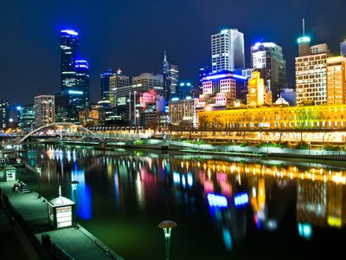
Australia
Inflation target: 2-3%
current inflation rate: 7%
IMF's 12m forecast rate: 4.8%

Slide 30
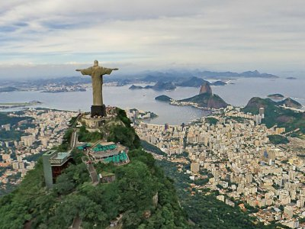
Brazil
Inflation target: 3.75% +/-1.5%
Current inflation rate: 4.65%
IMF's 12m forecast rate: 4.7%

Slide 31

China
Inflation target: 3.0%
Current inflation rate: 0.7%
IMF's 12m forecast rate: 2.2%

Slide 32
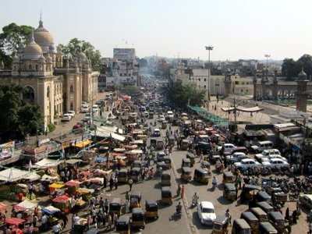
India
Inflation target: 4%+/-2.0%
Current inflation rate: 5.66%
IMF's 12m forecast rate: 5.1%

Slide 33
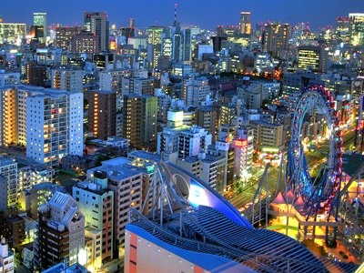
Japan
Inflation target: 2%
Currrent inflation rate: 3.2%
IMF’s 12m forecast rate: 1.4%

Slide 34

Turkey
Inflation target: 5% +/-2.0%
Current inflation rate: 43.68%
IMF's 12m forecast rate: 51.2%

Slide 35

United States
Inflation target: 2.0%
Current inflation rate: 5.0%
IMF’s 12m forecast rate: 3.5%

Slide 36
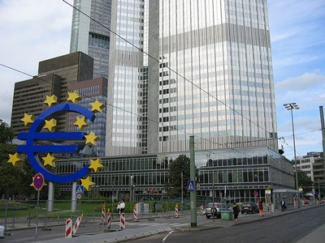
EuroArea
Inflation target: <2%
Current inflation rate: 8.4%
IMF's 12m forecast rate: 2.8%

